Slide 1
CUAS Notes on Workload: A Working Document
Mike Goodrich, Eric Mercer
TJ Gledhill, Robert Ivie, Jared Moore
Brigham Young University

Slide 2

Workload Is Not Busyness
Human activity can be “compiled”
Skill-based, rule-based, knowledge-base hierarchy (J. Rasmussen).
Skill-based activities don’t impact workload.
Rule-based and knowledge-based activities do impact workload.
People may be busy with skill-based activities, and not under high workload.

Slide 3

Workload Depends on Expertise
Experts spend their time differently than novices (G. Klein).
Novices spend little time on diagnosing a situation and much time enumerating alternative solutions.
Experts spend much time diagnosing a situation and little time selecting (using skill-based understanding) a solution.

Slide 4
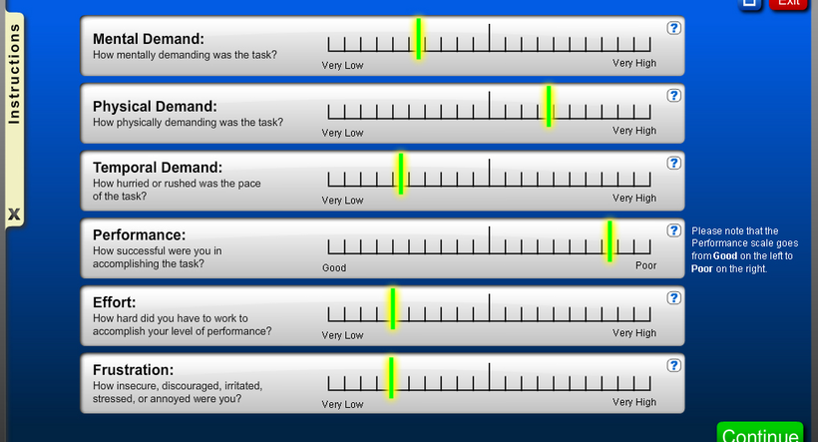
Workload Is Multi-Dimensional
NASA TLX

Slide 5
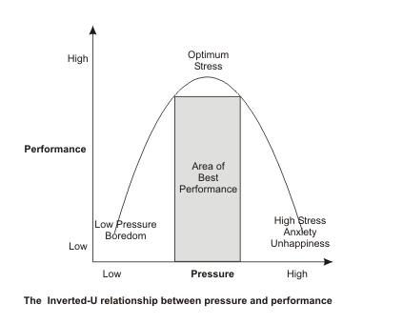
Performance Is What Really Matters
“[It] is not workload per se … [It] is whether the [human] can perform her job, with any margin of attention for unforeseen circumstances, stress, or complexities … [which] certainly do arise.” (Sheridan, p. 301)
Sheridan p. 307
Notes:
http://www.mindtools.com/stress/m/Diagrams/Inverted-U.GIF
Replace “pressure” with “workload” and you get Sheridan’s figure. His figure doesn’t have the annotations like stress, boredom, and anxiety either. I chose this figure because it provides some extra insights over the more simple figure in Sheridan’s book.

Slide 6
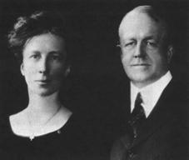
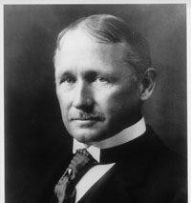
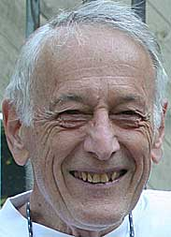
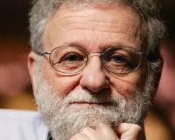
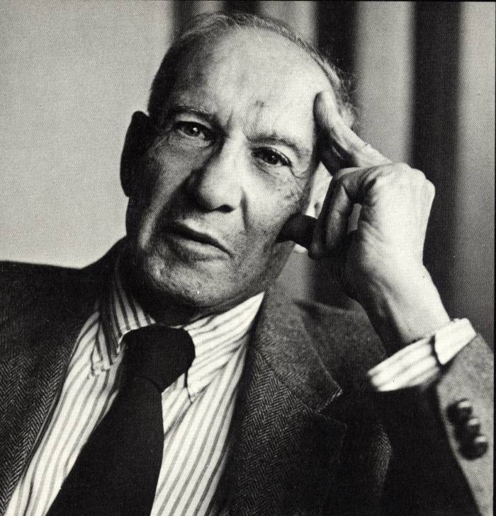
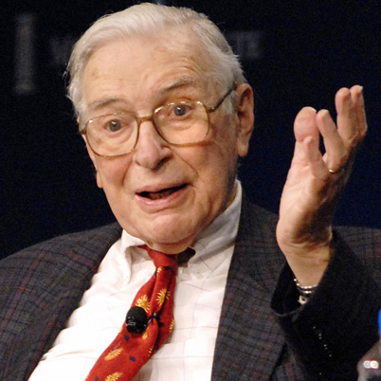

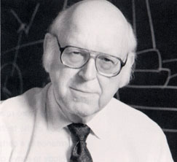
Elements of Workload Models: Key Historical Storylines
Time-and-motion and management science: The Gilbreths and F. W. Taylor
Human-machine interaction: Tom Sheridan and Don Norman
Organizational effects: Peter Drucker and Kenneth Arrow
Formal cognitive models: John Anderson and Alan Newell
Notes:
http://act-r.psy.cmu.edu/papers/233/10TH-CGF-LAB.pdf

Slide 7
Automation May Not Be The Answer
“… new technology will not render managers superfluous or replace them by mere technicians. On the contrary, [autonomy] will demand many more managers.”
Peter Drucker, The Practice of Management 1957
“… the increased interest in human factors among engineers reflects the irony that the more advanced a control system is, so the more crucial may be the contribution of the human operator”
Lisanne Bainbridge, Ironies of Automation, 1983
“The problem … is that the automation is at an intermediate level of intelligence, powerful enough to take over control that used to be done by people, but not powerful enough to handle all abnormalities … the automation should either be made less intelligent or more so.”
Don Norman, The Problem of Automation, 1990
Notes:
Automating new things can help, but only if embedded in a larger design context. The key is to design for the human-machine system as a whole. This leads to systematic design approaches a la Verplank’s on the next page.

Slide 8
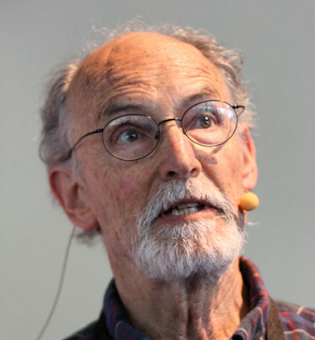
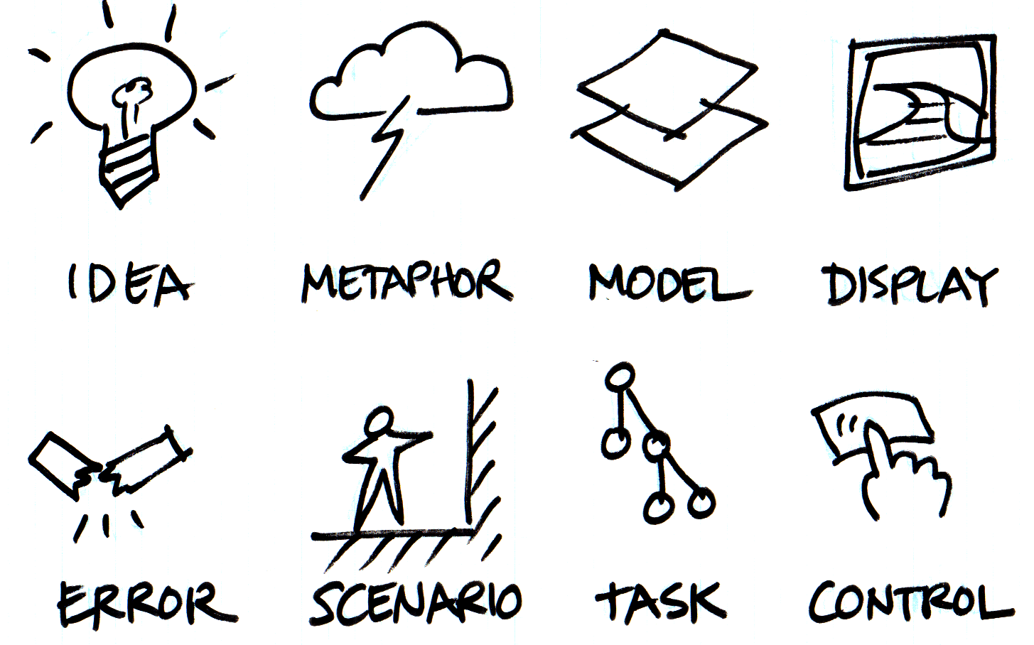
Workload Models Can Facilitate Effective Design
& SPECIFICATION
MODEL-CHECKING
Verplank
Notes:
https://ccrma.stanford.edu/courses/250a/images/id.png
Modelng is part of the design process. In this case, it follows metaphor and encodes the data + data relationships suggested by the metaphor.
A metaphor is used to represent or suggest a correct mental model, where the mental model identifies what data are necessary, how data evolves, and how data elements are related to each other.

Slide 9
What Can Model Tell Us About Workload?
Workload Elements
Model Checking
Model Specs
Workload Management

Slide 10
Workload: Possible Operational Definitions
Workload emerges where a task portfolio meets agent capabilities
Workload is a (tasks, agent) tuple
Implications of definitions
Workload can be defined for humans and artificial agents
Workload depends on both complexity of task portfolio and expertise of the agents involved
“As an analogy to one of the major models of individual workload (cf. Norman and Bobrow, 1975), team workload can be characterized as the relationship between the finite performance capacities of a team and the demands placed on the team by its performance environment.”*
*Team workload: Its Meaning and Measurement, Clint A. Bowers, Curt C. Braun, and Ben B. Morgan, Jr. chapter 5 in
Team Performance Assessment and Measurement: Theory, Methods, and Applications.
Edited by Michael T. Brannick, Eduardo Salas, and Carolyn W. Prince.
Notes:
Norman and Bobrow talk about the performance resource function, which shows how a resource can produce utility as a function of the amount of of resource dedicated to it. Depending on how much resource is dedicated to different tasks, different amounts of total (accumulated) utility are produced; this is represented, for one type of problem, namely those that are called “dual task problems”, as something called the performance operating characteristic. This suggests that workload is characterized by the relationship between capacity/expertise and task portfolio.

Slide 11
Needed
A review of using model-checking and formal methods in human-machine systems
Outcome 1: the need for new models and metrics
Models at a level of abstraction that allow us to estimate workload
Metrics that match up with these models
Comparison of these model-based workloads with real human workload data
Outcome 2: the need for models of team behavior
Get beyond a single human and single machine

Slide 12
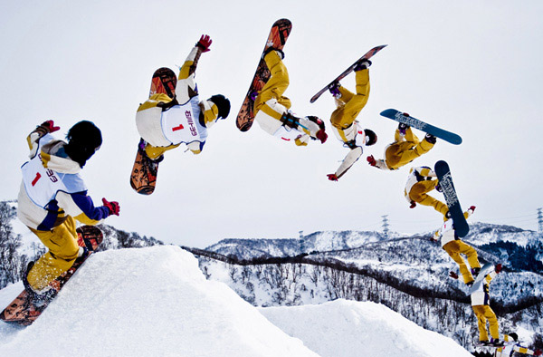
Elements of Workload: Allocation of a Resource
Temporal Resources
Cognitive Resources
Organizational Resources
Algorithmic Resources
Not Eric Mercer

Slide 13
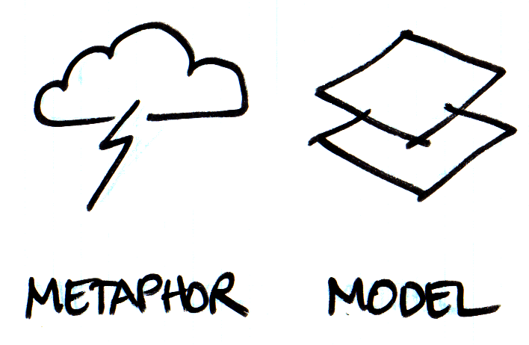
Temporal Resources
Job Shop
Constraints
Tempo
Frequency
Fan-Out
Notes:
Constraints
Portfolio: number of tasks, tempo of tasks
Environment
Metaphor: queuing theory

Slide 14
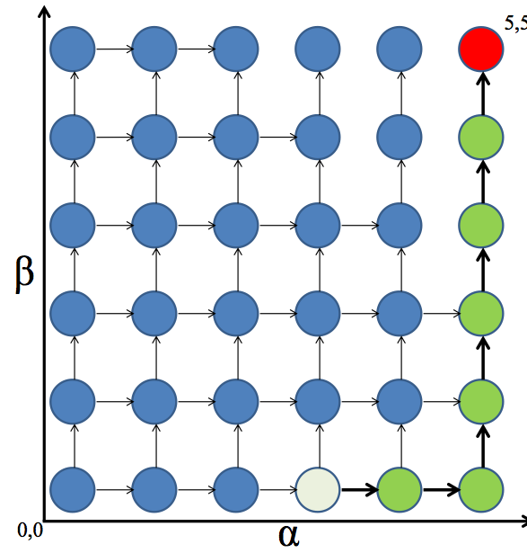
Temporal Resources
Constraints
Order: which comes first
Timing: deadlines
Operational tempo
Manage pacing of tasks
Fan-out (repetitive tasks)
Task neglect tolerance
Task interaction time
Tasks:
α,β
Constraints:
α_{T}≤ 7
NT
IT
IT
IT
Notes:
Constraints
Portfolio: number of tasks, tempo of tasks
Environment
Metaphor: queuing theory

Slide 15
Cognitive Resources
Computer Hardware
Parallel
Sequential
Multi-threaded

Slide 16
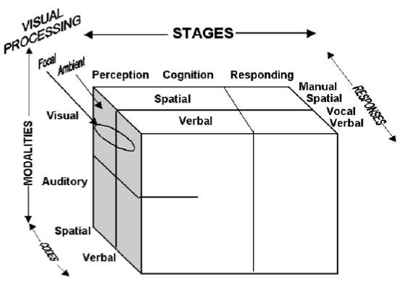
Cognitive Resources: Parallel Processing
Information Processing
Action Selection
Sensing
Most current workload models based on Wickens’s multiple resource theory
Notes:
Multiple Resources and Mental Workload Christopher D. Wickens, University of Illinois, Champaign, Illinois
http://www.interruptions.net/literature/Wickens-HF08.pdf
Take-home point: things can be done in parallel insofar as (a) they don’t cause overloading of the different perceptual channels (add haptic to the channels), (b) they are at different stages of information processing (e.g., no two tasks require cognition at the same time), and (b) don’t require the same output channel.

Slide 17
Cognitive Resources: Sequential Processing
Haptic
Auditory
Parallel
Sensing
Visual
Sequential
Decision-Making
Notes:
Pashler shows that, at the millisecond-level, tasks interfere with each other if they require decisions to be made (Pashler, H. E. (1998). The Psychology of Attention. Cambridge, Massachusetts, The MIT Press). In terms of Wickens’s model, this means that if two tasks both need a decision to be made at the same time, it can’t be done so the human must resort to some method for managing the conflict. This increases workload.

Slide 18
Cognitive Resources: Working Memory Bottleneck
Notes:
Mike’s model of memory and attention. Multi-tasking and Multi-Robot Management
The central executive is a problem because it assumes some ability to know when and how to “load” new facts and new mental models. This was postulated by Baddeley, but is considered a weak part of these theories (often referred to as the homonculus).

Slide 19
Cognitive Resources: Multi-Threaded
“The core idea of threaded cognition is that multitasking behavior can be represented as the execution of multiple task threads, coordinated by a serial cognitive processor and distributed across multiple processing resources” * … “without the need for specialized executive processes.”**
Key Assumptions:
“All resources … execute processing requests serially.”
“Threads acquire and release resources in a greedy, polite manner.”
When multiple threads contend … the least recently processed thread is allowed to proceed.
*Threaded Cognition: An Integrated Theory of Concurrent Multitasking. pg. 102
Salvucci & Taatgen, Psychological Review, 2008, Vol. 115, No. 1, 101–130
** Ibid, Abstract, pg. 101.

Slide 20
Organizational Resources
High-Performing
Team
Social Network

Slide 21
Organizational Resources
Decision-making is distributed
Memory
Agent’s know different things
Memory is transactive (Wegner)
Communication (Arrow)
Localized
Intent (model informs interpretation)
Required Mental Models (Fiore)
Teammate model: how is task performed
Team interaction model: what is topology
Team task model: who does & knows what
(Agent, Info)
(Task, Authority)
Notes:
Group resources: distributed control, distributed memory
Individual requirements: transactive memory, mental models
Facilitation: team communication, organization, network
http://www.wjh.harvard.edu/~wegner/pdfs/Wegner%20Transactive%20Memory.pdf

Slide 22
Algorithmic Resources
Artificial
Intelligence
Perceive, Think, Act
Algorithmic Complexity

Slide 23
Algorithmic Resources: Intelligence & Complexity
Difficulty of Problems
Solution depth
Solution Algorithms
Space complexity
Time complexity
Perceive
Think
Act

Slide 24


WiSAR Model
Actors
Video Analyst
UAV Operator
Mission Manager
Video GUI
UAV GUI
UAV
Environment
Actor Models: DiRG
Team
Team “wiring”
Team timing
Team Model: DiTG
V = {Actors}
E = {(M_{i},M_{j})}
Delta Clock Timing Model:
Priority queue of events
All actors receive synchronous signal when events trigger

Slide 25
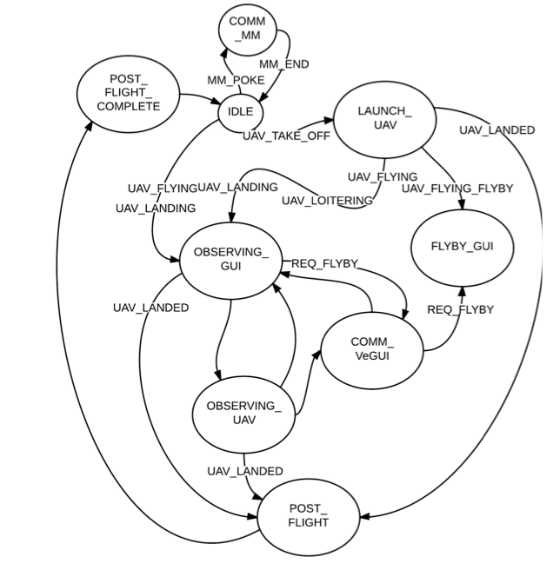
Directed Role Graph

Slide 26
Directed Team Graph (DiTG)
Parent Search
Mission Manager
Operator
Video Operator
Operator GUI
Video Operator GUI
UAV

Slide 27
What Causes “Work”
Parallel model
Channel conflicts
Shared memory conflicts
Sequential model
“Reload” working memory
“Refresh” perceptual channels
Temporal conflicts
Team model
Teaming mental models “crowd out” tasking mental models
Communication issues (delay, datasize, frequency)
Algorithmic
Task complexity
Memory saturation
High optempo

Slide 28
What Causes “Work”
Parallel model → Resource
Channel conflicts
Shared memory conflicts
Sequential model → Temporal
“Reload” working memory
“Refresh” perceptual channels
Temporal conflicts
Team model
Teaming mental models “crowd out” tasking mental models
Communication issues (delay, datasize, frequency)
Algorithmic → Decision
Task complexity
Memory saturation
High optempo

Slide 29
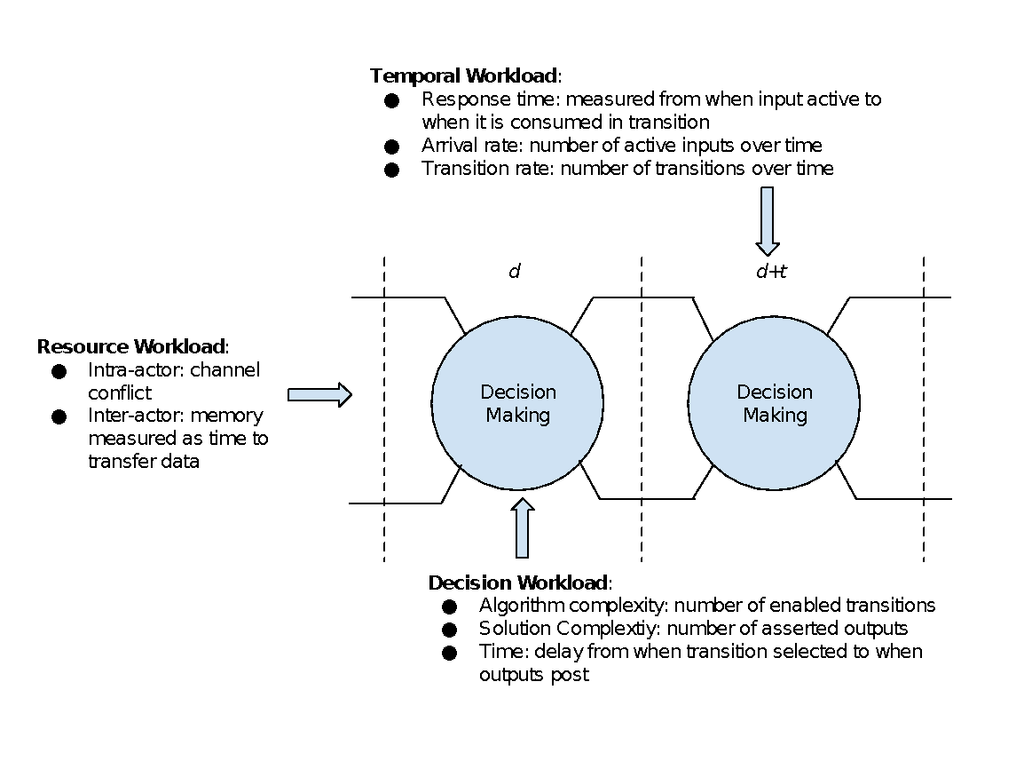
Model-Based Workload Metrics
Notes:
Recall that workload is a (task portfolio, agent) pair. Our set of task workload metrics is based on particular model of the agent. Therefore, our workload metrics assume that agent expertise is fixed, that is, it is encoded in the model. Thus, we are measuring the effects of task portfolio on the workload time history. If we try different models, we can get a feel for how agent expertise comes into play. This is a useful way to think because it helps us articulate the limitations of our model.

Slide 30
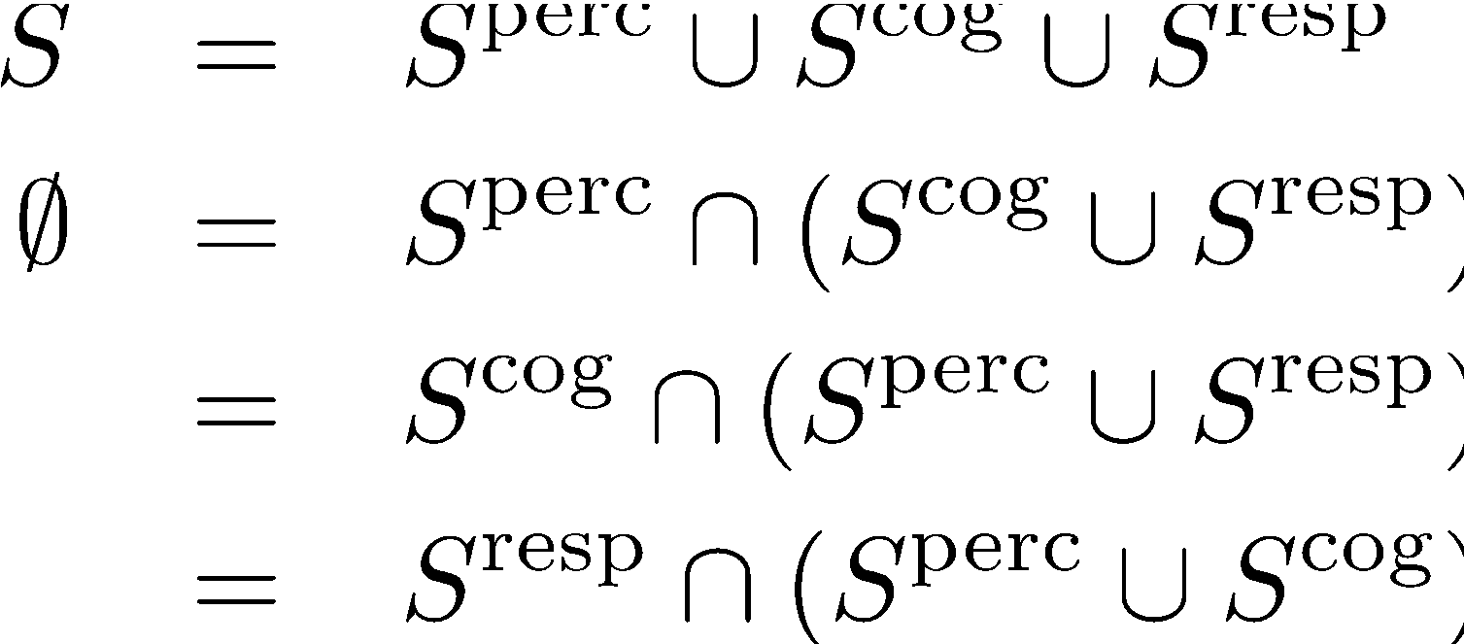
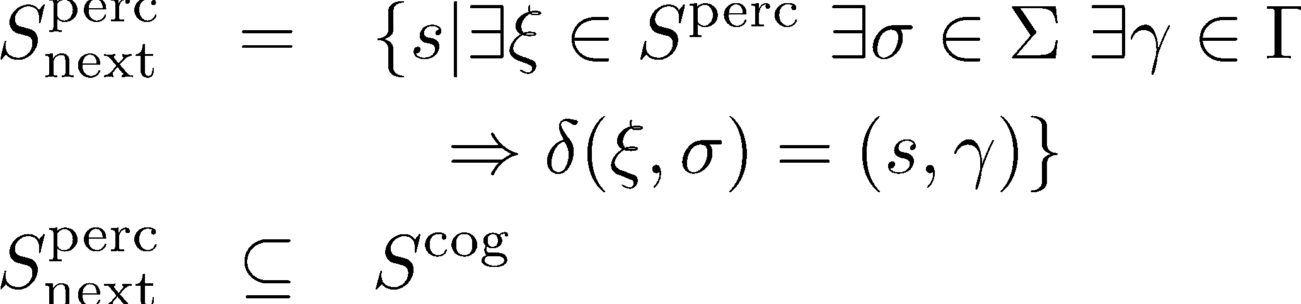
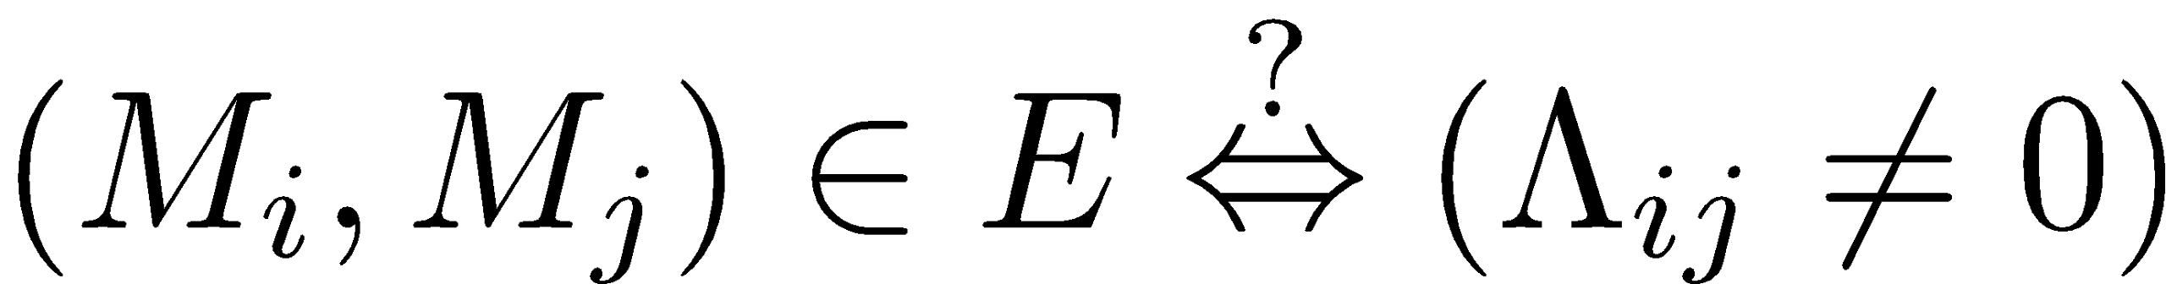
Augment Model to Enable Workload Tests: Needs Updating
Channel Consistency
Stage Conflicts
Augment ΣandΓ to include channel type
is channel type
is I/O message
Test DiTG transitions
Partition S into cognitive processing stages
Does transition relation satisfy cognitive flow, e.g.,
Notes:
S &=& S^{\rm perc} \cup S^{\rm cog} \cup S^{\rm resp} \\
\emptyset &=& S^{\rm perc} \cap (S^{\rm cog} \cup S^{\rm resp}) \\
&=& S^{\rm cog} \cap (S^{\rm perc} \cup S^{\rm resp}) \\
&=& S^{\rm resp} \cap (S^{\rm perc} \cup S^{\rm cog})
S_{\rm next}^{\rm perc} &=&\{s | \exists \xi \in S^{\rm perc} \ \exists \sigma \in \Sigma \ \exists \gamma\in\Gamma \\
&& \ \ \ \Rightarrow\delta(\xi,\sigma) = (s,\gamma)\} \\
S_{\rm next}^{\rm perc} &\subseteq& S^{\rm cog}

Slide 31
Possible Individual Workload Metrics: Needs Updating
Channel conflicts
Code DiTG edges for channel type (visual, aural)
If input vector to M_{i} uses multiple channels, W_{i}++
Task complexity
For event X, longest path through DiRG
Long paths imply long task sequence to remember
For event X, maximum DiRG transitions per unit time
Solution complexity
What is algorithmic (space and time) complexity required to transition from s \in S

Slide 32
Possible Team Workload Metrics: Needs Updating
Task complexity
For event X, count longest path through DiTG
Long paths imply long task sequence to remember
Long paths imply large group coordination
Maximum size of data-pipe between actors
Many bits imply much information sharing
Temporal complexity
Maximum size of delta clock priority queue
Large size implies large sequencing requirements
Maximum DiTG or DiRG transitions per unit time

Slide 33
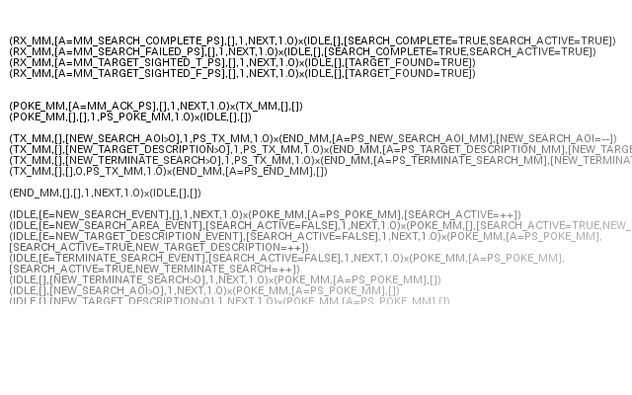
Validation
($Σ, \left[Χ= χ\right],\left[Ψ= ψ\right], Α, Δ, Π$) x ($Σ′, \left[Χ′= χ\right],\left[Ψ′= ψ\right]$)
$$\left(currentState , \left[channel=input,…\right], \left[memory=input, …\right], priority, duration, probability\right)x$$
$(nextState, \left[channel=output,…\right], [memory=output, …])$

Slide 34
Validation
A
B
E
C
D
F
G
H
I
J
K
Safety Properties
“This actor never has more than 5 enabled transitions.”

